Slide 1
COM 212: Data Structures
Stephen Douglass

Slide 2
Topics
Deque
Java Casting & Generics
Notes:
Homework 6 is out!!!

Slide 3
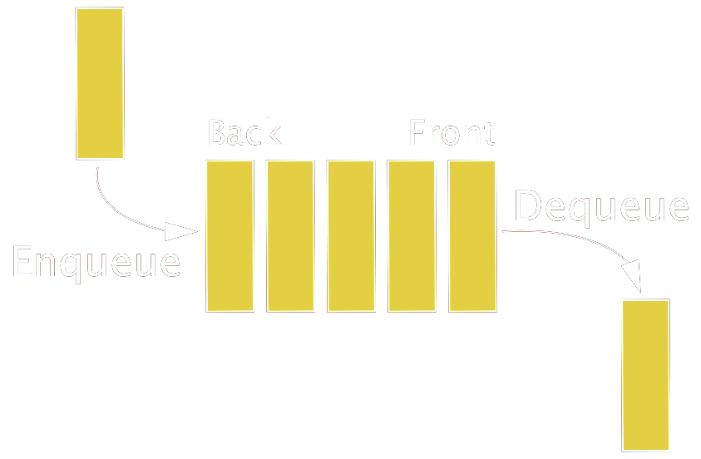
Queue
First-In-First-Out (FIFO): the first element added to the structure must be the first one to be removed (i.e. waiting list, printing jobs)
enqueue & dequeue (ops on both sides)

Slide 4
Deque (Double-ended Q)
Recall Queue ADT method
enqueue, dequeue, front, size, isEmpty
Delete from the front, add to the rear
Double-ended Queue (Deque “deck”)
Insertion and deletion at both the front and rear
Methods
addFirst(e), addLast(e), removeFirst(), removeLast(), getFirst(), getLast()

Slide 5
Deque Implementation
We want to implement deque simply and efficiently (runtime)
How we can implement deque?
Array or List (singly or doubly linked list)
Runtime
addFirst(e), removeFirst()
addLast(e), removeLast()
getFirst(), getLast()

Slide 6
Deque Application I
Palindrome Checker
A word, phrase, number, or other sequence of symbols or elements, that reads the same backwards as forwards
i.e. “radar”, “madam”, “level”
Add all symbols into Deque and compare two symbols (one from front, the other from rear) until only one left or empty
Use array to check palindrome?
Notes:
Too simple example??? We can do this with array by manipulating index progressively
int s = 0;
int e = symbols.length-1;
while (s < e) {
if (symbols[s++] != symbols[e--])
return false;
}
return true;

Slide 7
Deque Application II
Undo or history stack with limits
Stack ADT is generally good for history tracking (i.e. editor or web-browser history)
Should history support unlimited # of entries?
What if each entry requires large data space?
We will likely want to limit the total number of history entries (i.e. up to 20 entries)
Similar use case is “aging”: if node is older than certain time threshold, remove it from stack

Slide 8
Java Casting
Casting is a type conversion for objects
Consider Number and Integer Class (Integer is a subclass of Number)
Widening conversion: no need for explicit cast
Integer i = new Integer(5);
Number n = i;
Narrowing conversion: need explicit cast
Number n = new Integer(5);
Integer i = (Integer)n;

Slide 9
Java Casting
Number n;
Integer i;
n = new Integer(3);
i = (Integer) n;
n = new Double(3.1415);
i = (Integer) n;
Why we need a casting?
Imagine more flexible class can store various types of number (float, int, double, etc.)
Notes:
The first casting is legal whereas the second is illegal (compile ok but runtime exception)
public class MyNumber{
Number n;
public MyNumber (Number num) {
n = num;
}
public Number getNumber() { return n; }
}
MyNumber nf = new MyNumber (new Float(1.1));
System.out.println("float value: " + nf.getNumber());
MyNumber ni = new MyNumber (new Integer(2));
System.out.println("int value: " + ni.getNumber());

Slide 10
Java Generics
Generics framework to use abstract type to avoid many explicit casts
Generic type is a type that is not defined at compilation time, but becomes fully specified at run time
Define a class with a set of formal type parameters (with angle bracket <>)
i.e. make our previous DNode to store any type of values (elements)

Slide 11
Java Generics
public class DNode<E> {
private DNode<E> prev, next;
private E element;
public DNode(E elem, DNode<E> p, DNode<E> n) {}
public DNode<E> getNext() {}
public DNode<E> getPrev() {}
...
}
// DNode for string element
DNode<String> snode;
snode = new DNode<String>(“james”, null, null);

